Slide 1



International Stock Index Prediction Using Artificial Neural Network (ANN) and Python Programming K.KEERTHI Y.YASHWANTH TEJA B.PRAVEEN KUMAR

Slide 2
Introduction:
The stock market is one of the best channels for financial development that requires a high accuracy prediction of the trades.
This subject needs some technical skills and experience to achieve the best result.
This paper represents a tuned Python console program based on the Neural Network (NN), and the Artificial Intelligence (AI) to predict future price in a qualified and quantized way with high accuracy and close to real.
New ideas implemented in this paper are combining AI and NN model in the Python console system with a security shell that works with voice and PIN to authenticate the user.
It has Cross-Platform capability and supports cryptocurrencies price and their predictions. This program enables the user to have a duplication of the final data in his/her given email.
The proposed approach presents the influence of AI and Machine learning in nearly future predictions. This system can be used in the all kinds of subjects that include past time databases.

Slide 3

Domain:
Using Python:
Artificial Intelligence
Artificial Neural Network

Slide 4

Existing system:
In stock trading, it is very decorous that a model like NN provides a prediction nearly to the real price. Predicting the stock market is one of the processes that requires experience and reacquaint to have an accurate prediction. However, this process is qualitative and cannot be a complete prediction.
Disadvantage of existing system:
Mean Squared Error (RMSE) values for future that is more reliable than qualitative predictions.
Output is not useful to predict the future data.

Slide 5

Proposed system:
This program proposes an attention-based short-term and memory model to predict the international stock price trend and all system runs on python. The model consists of five layers: shell layer, input layer, hidden layer, attention layer, and output layer.
The shell layer authenticate the user.
The input layer reads the input data that meet the input requirements.
The hidden layer is correlated to the linear network through the LSTM unit.
The attention layer prepares future amounts based on the predictions that are performed in the hidden layer.
The output layer receives the final measured results to show for the user. The proposed framework is illustrated in the LSTM method.

Slide 6
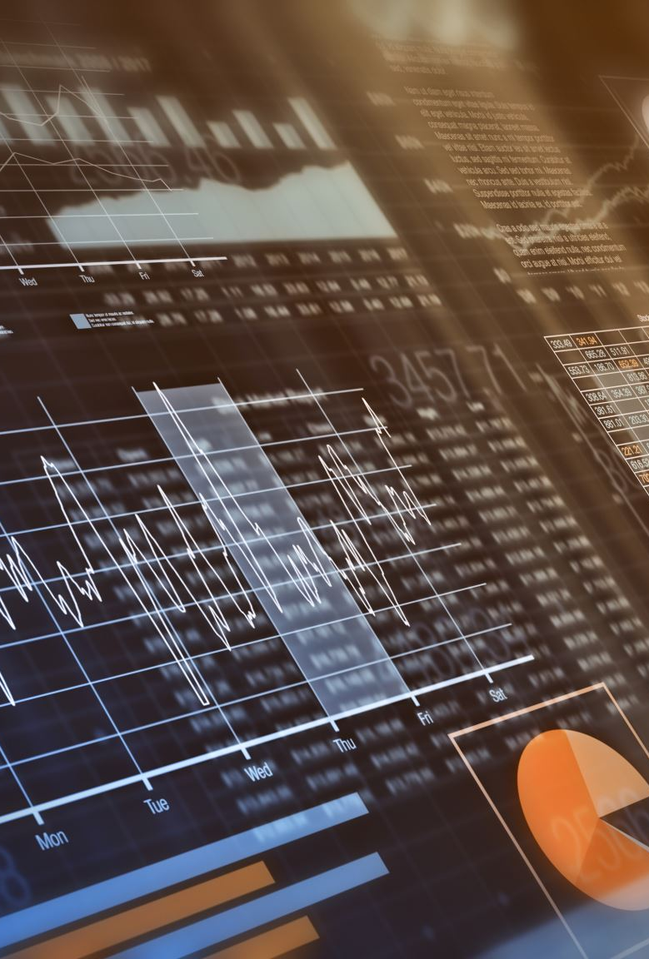
Advantages of proposed system:
To make complicated approaches for accurate prediction close to the real value.
The results validate the possibility and correctness of the program and the prediction. The experiment compared with the prediction that indicated with classic ways, validates the correctness of the proposed python program.
Algorithm: Artificial Intelligence, Artificial Neural Network (ANN), International Stock Prediction, LSTM, Python Programming.

Slide 7

Hardware requirements:
System : Intel Core i5.
Hard Disk : 500GB.
Monitor : 15'' LED
Input Devices : Keyboard, Mouse
Ram : 32GB.

Slide 8
SOFTWARE REQURIMENTS:
Operating System : windows 10.
Coding Language : Python
Tool : PyCharm, Visual Studio Code
Front-end : Html, CSS
Designing : Html, CSS, javascript
Database : SQLite

Slide 9

Modules:
User
Admin
Data Preprocessing
Machine Learning

Slide 10
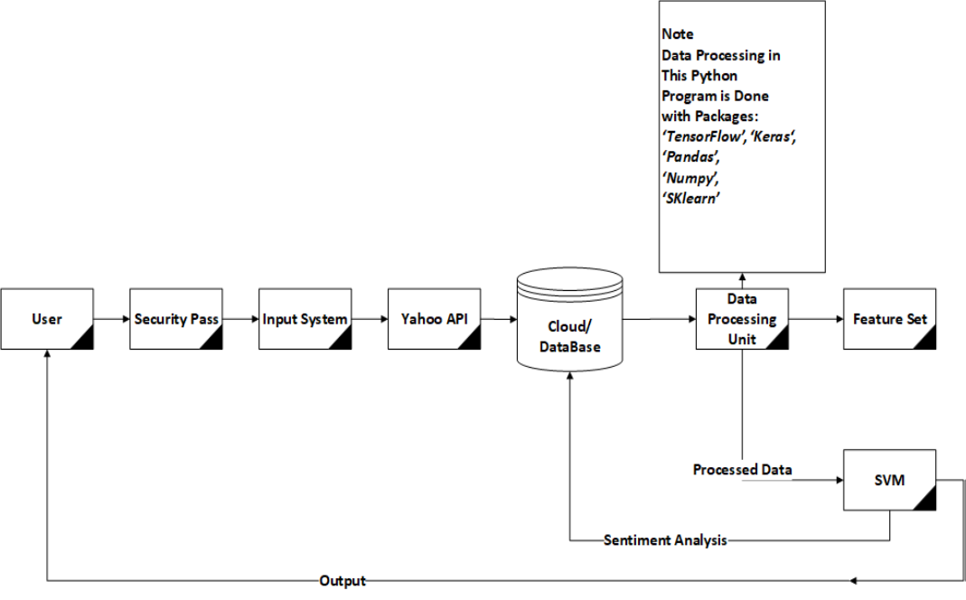
SYSTEM DESIGN
SYSTEM ARCHITECTURE :

Slide 11
SYSTEM STUDY:
FEASIBILITY STUDY :
The feasibility of the project is analyzed in this phase and business proposal is put forth with a very general plan for the project and some cost estimates. During system analysis the feasibility study of the proposed system is to be carried out. This is to ensure that the proposed system is not a burden to the company. For feasibility analysis, some understanding of the major requirements for the system is essential.
Three key considerations involved in the feasibility analysis are,
ECONOMICAL FEASIBILITY
TECHNICAL FEASIBILITY
SOCIAL FEASIBILITY

Slide 12
ALGORITHMS:
EXISTING SYSTEM:
Random Forest
KNN Model
Support Vector Machines (SVM).

Slide 13
Algorithm:
PROPOSED SYSTEM:
Artificial Intelligence
Artificial Neural Network (ANN)
International Stock Prediction
LSTM
Python Programming.

Slide 14

FUTURE ENHANCEMENT:
In this paper, for Stock Prediction based on the LSTM machine learning, the AI, Python Programming, and International Stock Market was carried out on analysis with the deep learning and AI frameworks in the Python operating system. As an experiment, the program used to predict the future price and the graph of the prediction plots in three different times for stock AMZN.

Slide 15
CONCLUSION:
Stock Prediction based on the LSTM machine learning, the AI, Python Programming, and International Stock Market was carried out on analysis with the deep learning and AI frameworks in the Python operating system. As an experiment, the program used to predict the future price and the graph of the prediction plots in three different times for stock AMZN. In this order, the results validate the possibility and correctness of the program and the prediction. The experiment compared with the prediction that indicated with classic ways, validates the correctness of the proposed Python program. Therefore, this method can be extended to different applications such as financial applications and educational applications.

Slide 16


